Slide 1



Proposal of a new power data format - motivation & draft -
Presenter:
Lasse Svenningsen

Slide 2
Outline
Current PC format…
…Challenges
…A solution
Draft of a new power data format
Use of new format?
Summary, limitations & alternative
Next steps: feedback & input needed

Slide 3
Current PC format
Typical AEP calculations

Slide 4
Current PC format
Typical AEP calculations
Available data:
Power and Ct curve at std. conditions* for a set of air densities
Power (and Ct?) at std. air density and conditions and for a set of noise modes
1/3 octave band data of source noise for each of the noise modes
*) May be site specific (TI, shear, ..)

Slide 5
Current PC format
Typical AEP calculations
Available data:
Power and Ct curve at std. conditions* for a set of air densities
Power (and Ct?) at std. air density and conditions and for a set of noise modes
1/3 octave band data of source noise for each of the noise modes
Format:
Typically, tables in a pdf or excel
*) May be site specific (TI, shear, ..)

Slide 6
Current PC format
Typical AEP calculations
Available data:
Power and Ct curve at std. conditions* for a set of air densities
Power (and Ct?) at std. air density and conditions and for a set of noise modes
1/3 octave band data of source noise for each of the noise modes
Format:
Typically, tables in a pdf or excel
Possible corrections:
E.g. IEC61400-12-1 ed. 2 corrections for rho, TI, shear, etc.
*) May be site specific (TI, shear, ..)

Slide 7
Challenges
Current challenges:
Many turbines run wholly or partly in “Special Operation Modes” (SOM)
- E.g.: Noise, Load, Power/Boost, High/low temp., (High wind), …

Slide 8
Challenges
Current challenges:
Many turbines run wholly or partly in “Special Operation Modes” (SOM)
- E.g.: Noise, Load, Power/Boost, High/low temp., (High wind), …
SOM’s are not ‘power optimal’ (→ standard corrections do not work)

Slide 9
Challenges
Current challenges:
Many turbines run wholly or partly in “Special Operation Modes” (SOM)
- E.g.: Noise, Load, Power/Boost, High/low temp., (High wind), …
SOM’s are not ‘power optimal’ (→ standard corrections do not work)
III) The effect/benefit of the SOM on AEP is not quantified
- Manufacturers or consultants need to show the added value or limited loss

Slide 10
Challenges
Current challenges:
Many turbines run wholly or partly in “Special Operation Modes” (SOM)
- E.g.: Noise, Load, Power/Boost, High/low temp., (High wind), …
SOM’s are not ‘power optimal’ (→ standard corrections do not work)
III) The effect/benefit of the SOM on AEP is not quantified
- Manufacturers or consultants need to show the added value or limited loss
IV) Manual copy paste from e.g. pdf’s, increase risk of human errors

Slide 11
A Solution
Main ideas for a solution:
Power data MUST include full dependence on relevant climate variables

Slide 12
A Solution
Main ideas for a solution:
Power data MUST include full dependence on relevant climate variables
Power data MUST include ‘reference mode’ to quantify effect of SOM’s

Slide 13
A Solution
Main ideas for a solution:
Power data MUST include full dependence on relevant climate variables
Power data MUST include ‘reference mode’ to quantify effect of SOM’s
All the relevant data/info compiled in one file

Slide 14
A Solution
Basic assumptions/decisions:
Self-contained and ~self-explained format

Slide 15
A Solution
Basic assumptions/decisions:
Self-contained and ~self-explained format
Keep math as simple as possible, to ensure 100% reproducibility

Slide 16
A Solution
Basic assumptions/decisions:
Self-contained and ~self-explained format
Keep math as simple as possible, to ensure 100% reproducibility
Special operation modes mutually exclude each other (or fixed combination)

Slide 17
A Solution
Basic assumptions/decisions:
Self-contained and ~self-explained format
Keep math as simple as possible, to ensure 100% reproducibility
Special operation modes mutually exclude each other (or fixed combination)
Wind shear can be handled as explicit parameter or using REWS

Slide 18
Draft of a new format
The basic outline:
A single zip-file containing:

Slide 19
Draft of a new format
The basic outline:
A single zip-file containing:
XML-file with basic info, list of SOMs and climate variables
II) Mat files for each SOM giving power or Ct dependence of climate variables

Slide 20
Draft of a new format
The basic outline:
A single zip-file containing:
Keeps everything together, yet easy to extract/view
Encryption + license protection in windPRO optional for project specific use
XML-file with basic info, list of SOMs and climate variables
II) Mat files for each SOM giving dependence of climate variables

Slide 21
Draft of a new format
The basic outline:
A single zip-file containing:
XML-file with basic info, list of M SOMs and N climate variables
- Structured
- Human readable
- Extendable
II) Mat files for each SOM giving dependence of N climate variables

Slide 22
Draft of a new format
The basic outline:
A single zip-file containing:
XML-file with basic info, list of SOMs and climate variables
II) 2 Mat files for each of M SOM’s giving dependence of N climate var.
- 1 Mat file = 1 data matrix (with N dimensions)
- Standard binary data format, supported by Matlab, Python, R, …
- Power versus N relevant climate variables
- Ct versus N relevant climate variables
(- Source noise versus 1/3-octave band and wind speed)

Slide 23
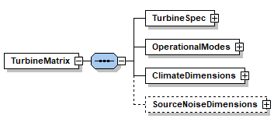
Draft of a new format
The XML file:
Draft structure (xml schema)

Slide 24
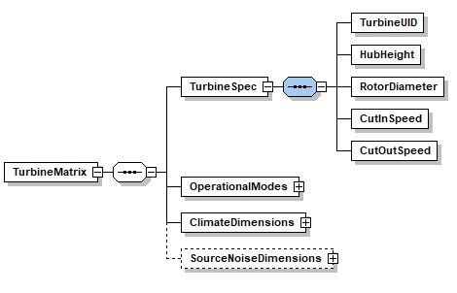
Draft of a new format
The XML file:
Draft structure (xml schema)

Slide 25
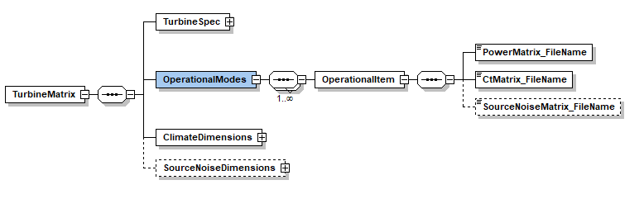
Draft of a new format
The XML file:
Draft structure (xml schema)

Slide 26
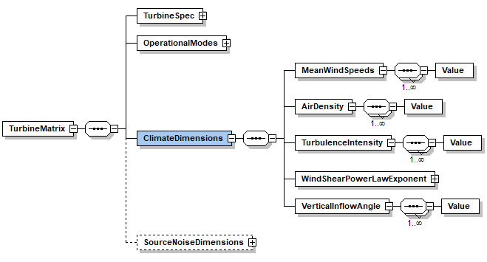
Draft of a new format
The XML file:
Draft structure (xml schema)

Slide 27
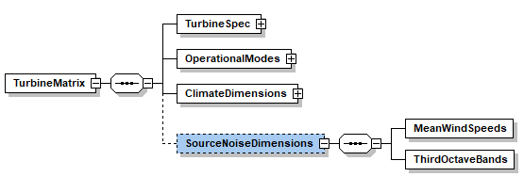
Draft of a new format
The XML file:
Draft structure (xml schema)

Slide 28
Draft of a new format
The Mat files:
One mat file for power and one for Ct, for each SOM

Slide 29
Draft of a new format
The Mat files:
One mat file for power and one for Ct, for each SOM
Each mat file has N dimensions, representing N climate variables

Slide 30
Draft of a new format
The Mat files:
One mat file for power and one for Ct, for each SOM
Each mat file has N dimensions, representing N climate variables
Example N=3 climate dimensions, power matrix:

Slide 31
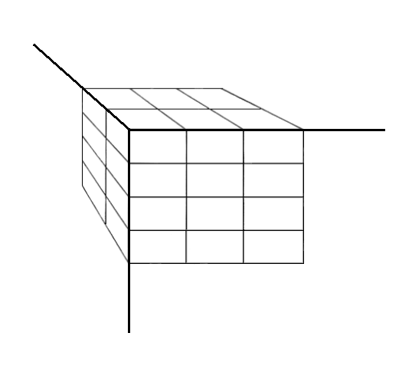
Draft of a new format
The Mat files:
One mat file for power and one for Ct, for each SOM
Each mat file has N dimensions, representing N climate variables
Power values (p_{i,j,k})
Turbulence (k)
Example N=3 climate dimensions, power matrix:
Wind speed (i)
P_{1,1,1}
P_{i,j,k}
Air density (j)

Slide 32
Use of power and Ct matrices
How to ‘extract’ power or Ct values
ONLY via multi-linear interpolation in defined parameter order

Slide 33
Use of power and Ct matrices
How to ‘extract’ power or Ct values
ONLY via multi-linear interpolation in defined parameter order
Extrapolation NOT allowed, truncation at the ‘edges’

Slide 34
Use of power and Ct matrices
Simple example 1:
Modes: {‘Mode 0 (reference)’, ‘Noise 1’, ‘Noise 2’, ‘Noise 3’}
Climate variables: {Wind speed, Air density, Turbulence}
Parameters: {Power, Ct}
I.e.:
4 power Mat-files each with 3 climate dimensions
4 Ct Mat-files each with 3 climate dimensions

Slide 35
Use of power and Ct matrices
Simple example 1 cont’d:
Operation strategy, turbine X:
Mode 0: 08-16h
Noise 1: 16-20h
Noise 3: 20-08h
AEP calculation:
in each time step find mode from turbine strategy (set at each WTG)
extract power and Ct for mode using wind speed, air density, turbulence
extract power and Ct for ref. mode using wind speed, air density, turbulence
etc. …

Slide 36
Use of power and Ct matrices
Simple example 2:
Modes: {‘Reference’, ‘Boost’, ‘Load’}
Climate variables: {Wind speed, Air density, Turbulence, Shear}
Parameters: {Power, Ct}
I.e.:
3 power Mat-files each with 4 climate dimensions
3 Ct Mat-files each with 4 climate dimensions

Slide 37
Use of power and Ct matrices
Simple example 2 cont’d:
Operation strategy, turbine Y:
Reference: If not below
Boost: TI≤0.16 & u≥12m/s & dir ∈{15; 170}
Load: TI≥0.22
AEP calculation:
in each time step find mode from turbine strategy (set at each WTG)
extract power and Ct for mode using wind speed, air density, turbulence
extract power and Ct for ref. mode using wind speed, air density, turbulence
etc. …

Slide 38
Use of power and Ct matrices
How do you make the Mat files?:
Up to the individual manufacturers!
Could be based on aero-elastic simulations
Could be based on in-house PC correction models
Could even be based on measurements or basically anything!

Slide 39
Summary, limitations & alternative
Summary:
Many turbines run partly/wholly in ‘SOM’
Standard corrections don’t necessarily apply
A reference mode important to quantify effect of ‘SOM’
Our proposed format: simple math, ensure reproducibility
=> a more complete set of self-explained data

Slide 40
Summary, limitations & alternative
Summary:
Many turbines run partly/wholly in ‘SOM’
Standard corrections don’t necessarily apply
A reference mode important to quantify effect of ‘SOM’
Our proposed format: simple math, ensure reproducibility
=> a more complete set of self-explained data
Limitations:
Cannot directly handle hysteresis behaviour
Controller behaviour must be reflected in the power/Ct data
Wind profile parameterised via shear exponent (could be handled)

Slide 41
Summary, limitations & alternative
Summary:
Many turbines run partly/wholly in ‘SOM’
Standard corrections don’t necessarily apply
A reference mode important to quantify effect of ‘SOM’
Our proposed format: simple math, ensure reproducibility
=> a more complete set of self-explained data
Limitations:
Cannot directly handle hysteresis behaviour
Controller behaviour must be reflected in the power/Ct data
Wind profile parameterised via shear exponent (could be handled)
Alternative?:
An interface to ‘black box’ dlls…

Slide 42
Next steps
We need feedback:
Questions/suggestions are much welcome!
At a short web meeting in the no too distant future?
- Interested? Please mail: LS@emd.dk or give me a business card.
With today’s input we will make a draft documentation + example
- We can send that out prior to a web-meeting.
Can be available in windPRO 3.2 in a first version.

Slide 43
The End
Thanks for your attention!

